Slide 1


NTUA Report 21/12/2020
Georgios Bakas

Slide 2
Outline
CERN and the CMS Experiment
Detector Control System
Data Analysis
Detector Upgrades
RD51
Conclusions

Slide 3
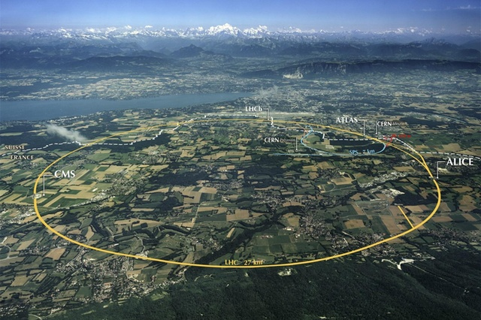
CERN – LHC
CERN, European laboratory for particle and nuclear physics.
Various experiments.
Large Hadron Collider (LHC)
27Km circumference
Colliding Protons
Design energy up to 14 TeV.
Beams collide at 4 predefined points.
4 detectors/experiments.
ALICE, ATLAS, CMS, LHCb

Slide 4
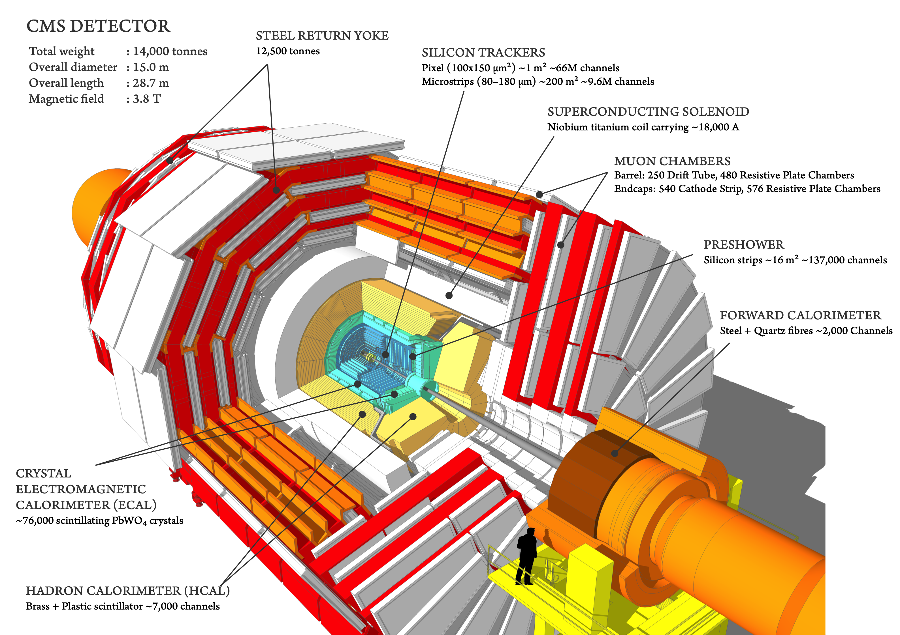
CMS Experiment

Slide 5
Detector Control System
Control the detector
Monitor the conditions under which it operates
Sophisticated and sensitive equipment (more than 6 million parameters)
Take necessary actions
Use the collected data as a first indication for determining the quality of the physics data collected.

Slide 6
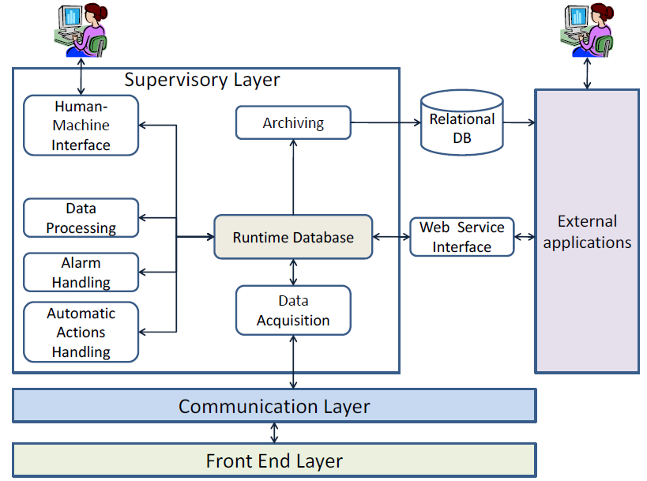
Control Systems
SCADA system (Supervisory Control And Data Acquisition)
Monitor and Control a remote process
Factories, airports, physics experiments
Toolkits
Tools for developing the supervisory layer
Ability to connect to hardware (communication layer, drivers)

Slide 7






Control Systems at CERN
Experiment’s Framework
JCOP
FW
Distributed Systems
Runtime Database
OS Independent
Native language, GEDI
Embedded drivers
WinCC_OA

Slide 8

The CMS Detector Control System
Central System
More than 35 individual systems
Minimal systems modified by a bunch of JCOP-like CMS components
Centralized
Central DCS responsible for the maintenance of all the projects
DCS Shifter
Tracker
ECAL
HCAL
Muons
…

Slide 9
Role in the DCS
Members of the CMS central DCS team
System administration
Maintenance and improvement of the existing system
Developed/improved various applications used either in the control room by the operators or by subsystem experts
Support in the CMS experiment in control system manners. Problem fixing or suggestions for future developments

Slide 10
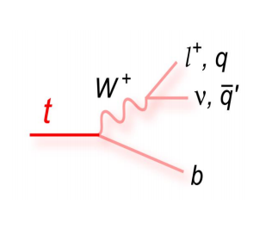
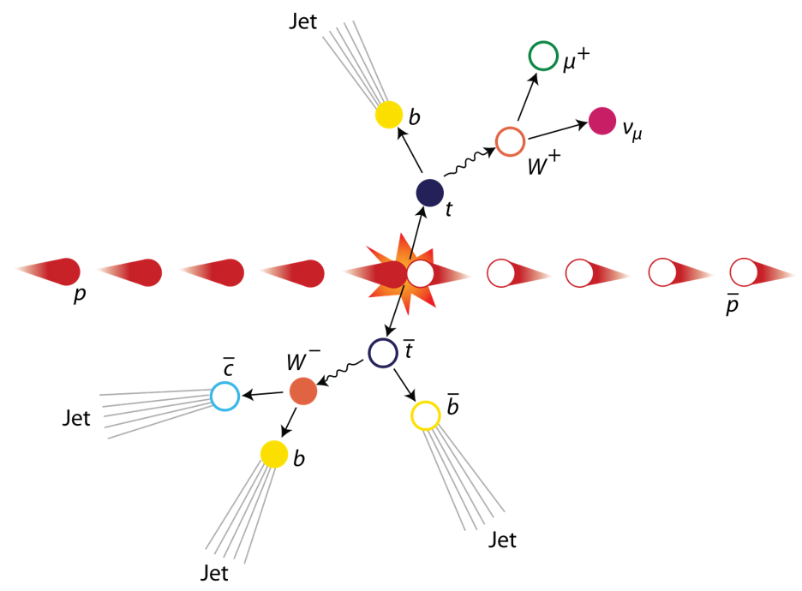
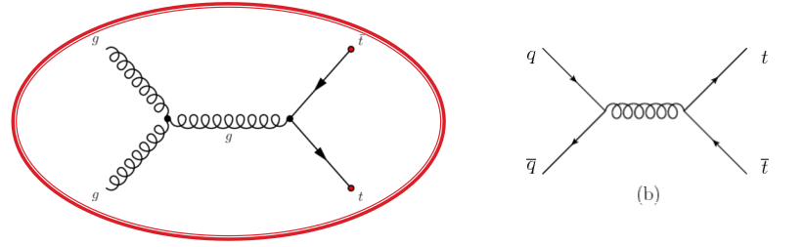
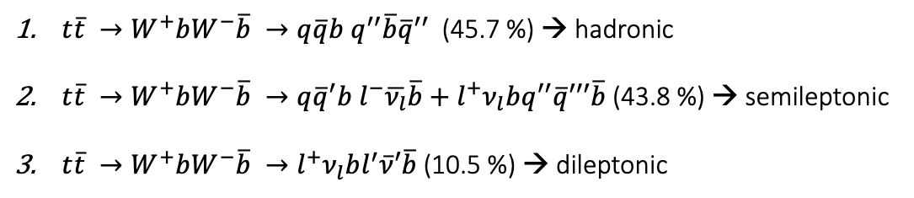
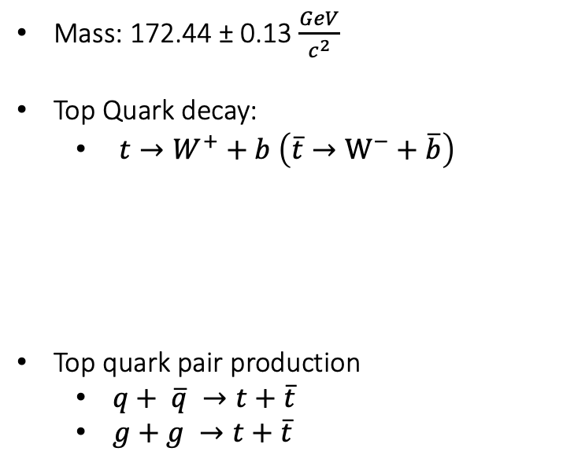
Top Quark -- Top AntiTop system decay
Mass: 172.44 ± 0.13 $\frac{GeV}{c^{2}}$
Top Quark decay:
$t→W^{+}+b \left(\overline{t}→W^{−}+\overline{b}\right)$
Top quark pair production
$q+ \overline{q} →t+\overline{t}$
$g+g →t+\overline{t}$
$t\overline{t} →W^{+}bW^{−}\overline{b} →q\overline{q}b q^{′′}\overline{b}{\overline{q}}^{′′}$ (45.7 %) → hadronic
$t\overline{t} →W^{+}bW^{−}\overline{b} →q{\overline{q}}^{′}b l^{−}\overline{ν_{l}}\overline{b}+l^{+}ν_{l}bq^{′′}\overline{q}′′′\overline{b}$ (43.8 %) → semileptonic
$t\overline{t} →W^{+}bW^{−}\overline{b} →l^{+}ν_{l}bl^{′}\overline{ν}′\overline{b}$(10.5 %) → dileptonic
Gluon Fusion is dominant at LHC

Slide 11
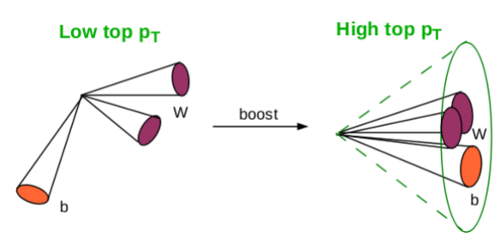
Boosted Jets
Boosted Jets are jets with high p_{T} ( > 400 GeV)
Aim is the reconstruction of two big jets that contain the decay products of the top-antitop quark pair decay
Motivation
With resolved hypothesis we measure the top pair cross section up to ~500GeV
There is an interesting discrepancy with theory (p_{T} slope)
In order to see what happens in bigger p_{T} ‘s → boosted
Why Boosted jets?
Single “fat” jet: No combinatorial background
At high top p_{T} the hadronic decay is easier to reconstruct than the leptonic
In order to identify boosted jets
Use of sophisticated reconstruction techniques to identify the substructure within the jet
SoftDrop technique to eliminate soft contributions

Slide 12
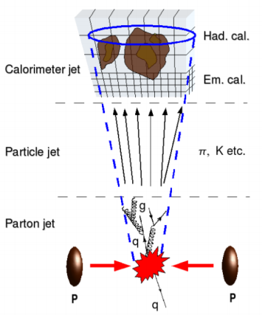
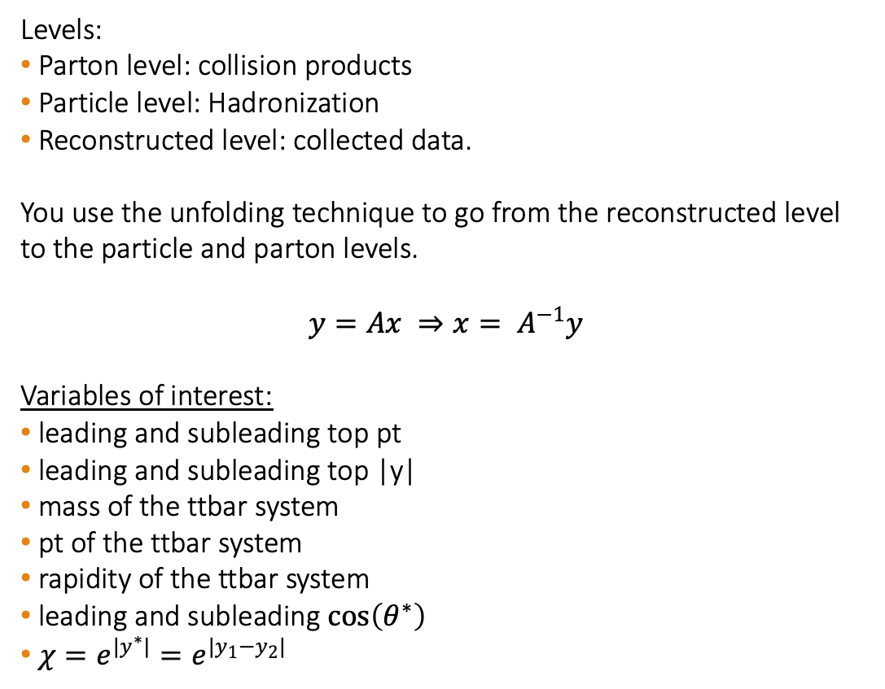
Analysis Overview
Levels:
Parton level: collision products
Particle level: Hadronization
Reconstructed level: collected data.
You use the unfolding technique to go from the reconstructed level to the particle and parton levels.
$$y=Ax ⇒x= A^{−1}y$$
Variables of interest:
leading and subleading top pt
leading and subleading top |y|
mass of the ttbar system
pt of the ttbar system
rapidity of the ttbar system
leading and subleading $\cos\left(θ^{∗}\right)$
$χ=e^{{|y}^{∗}|}=e^{|y_{1}−y_{2}|}$

Slide 13
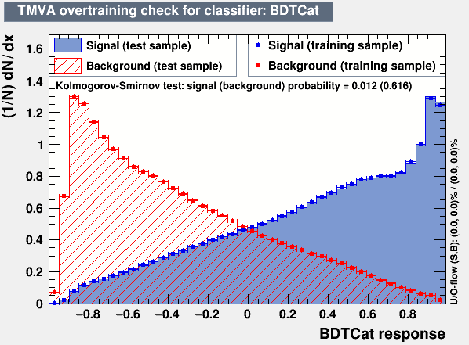
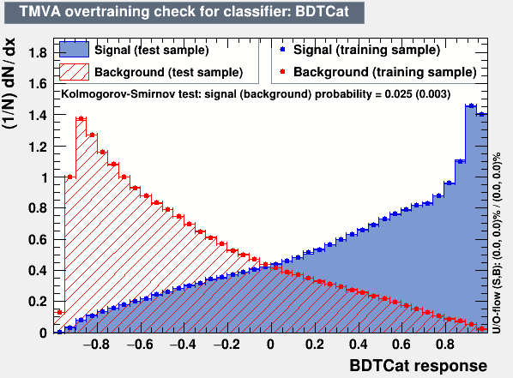
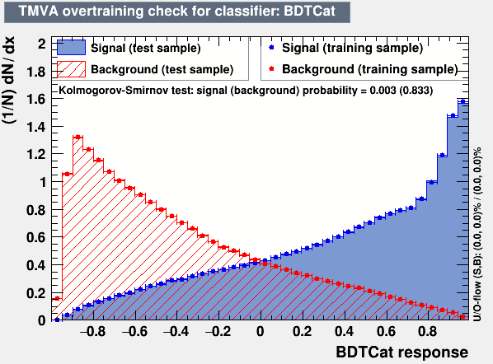
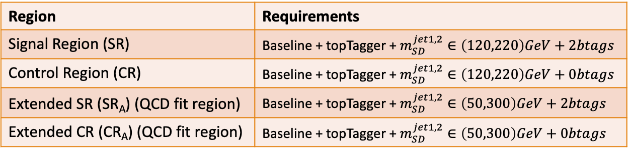
Overview
Region | Requirements
Signal Region (SR) | Baseline + topTagger + $m_{SD}^{jet1,2}∈\left(120,220\right)GeV+2btags$
Control Region (CR) | Baseline + topTagger + $m_{SD}^{jet1,2}∈\left(120,220\right)GeV+0btags$
Extended SR (SR_{A}) (QCD fit region) | Baseline + topTagger + $m_{SD}^{jet1,2}∈\left(50,300\right)GeV+2btags$
Extended CR (CR_{A}) (QCD fit region) | Baseline + topTagger + $m_{SD}^{jet1,2}∈\left(50,300\right)GeV+0btags$
Baseline Parton cuts:
Jet Matching
partonPt[0],[1] > 400
|partonEta[0],[1]| < 2.4
mTTbarParton > 1000
Baseline Reconstructed level cuts:
nJets > 1, nLeptons = 0, Dijet mass (mJJ) > 1000
Leading and Subleading jet p_{T} > 400
Leading and Subleading absolute jet eta |η|<2.4
2016
2017
Btagging selection
In house developed top Tagger:
Working points (2016: 0.2, 2017: 0.0, 2018: 0.1)
Goal is to Unfold to the Parton And Particle Levels
Data driven method for QCD subtraction
Closure Tests with Nominal MC’s
2018

Slide 14
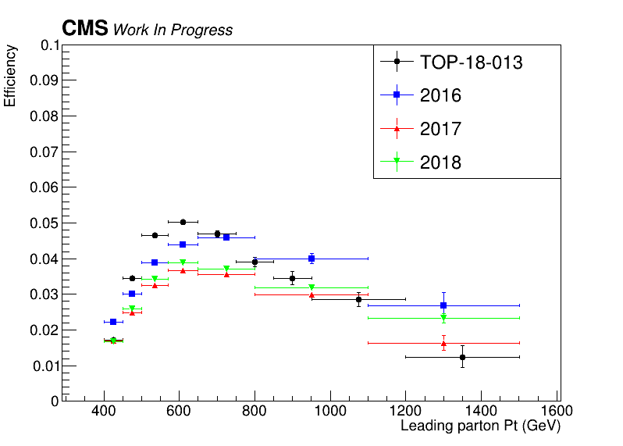
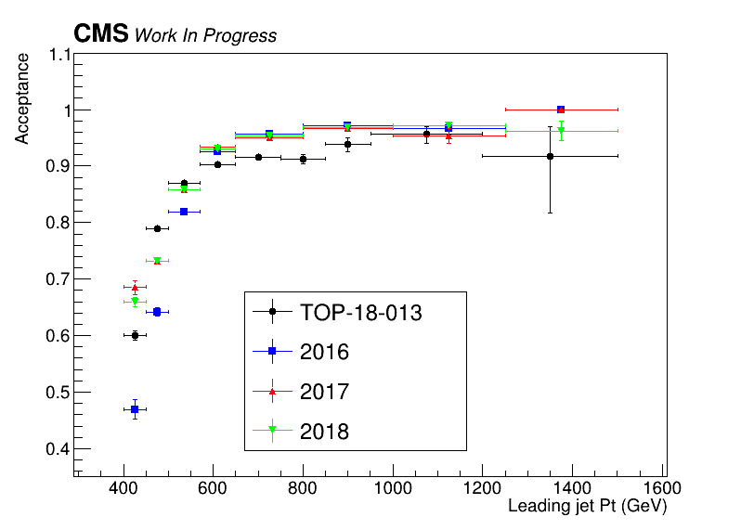
Efficiency and Acceptance for 2016, 2017 and 2018 and previous 2016 analysis

Slide 15
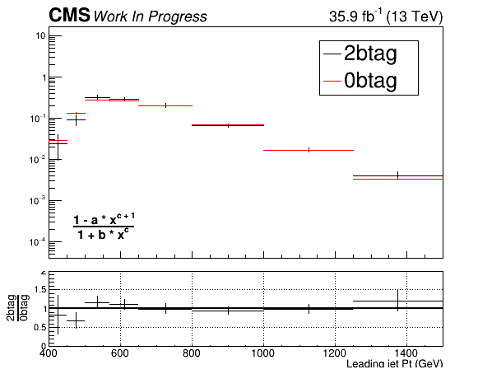
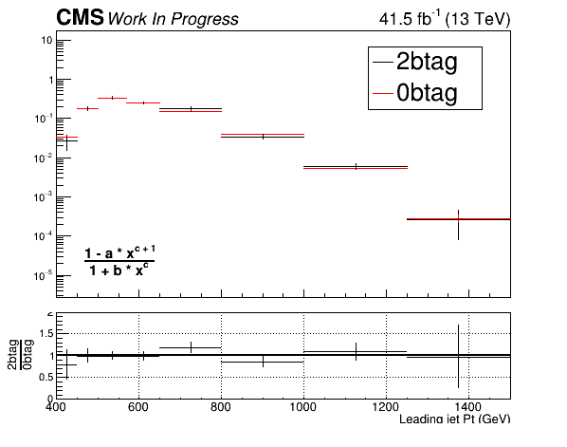
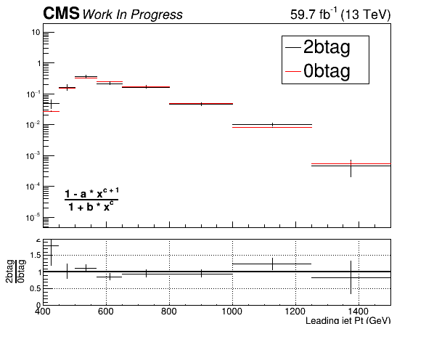
QCD Closure Tests ’16, ‘17, ’18 (corrected) for leading JetPt
2016
2017
2018

Slide 16
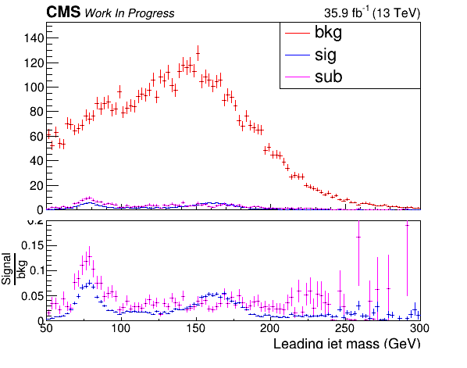
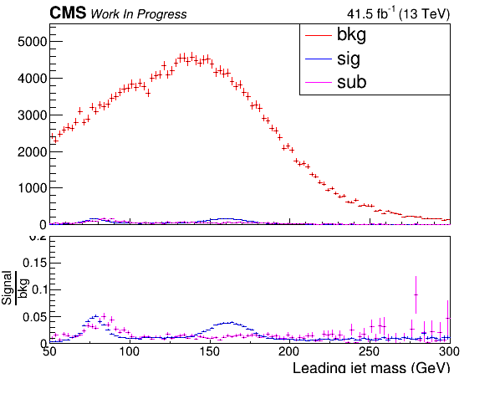
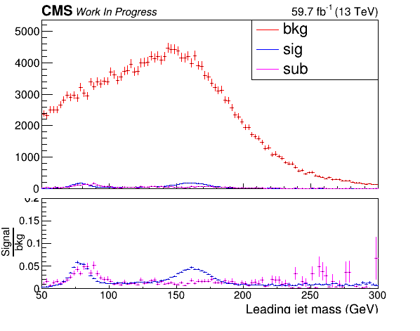
CR Contamination ’16,’17,’18 for the leading Jet Mass (softDrop)
2016
2017
2018

Slide 17
Signal Extraction
Fitted number of QCD events in SR_{A}
Measured dist from data
QCD shape taken from Data (CR)
$$S\left(x_{reco}\right)=D\left(x_{reco}\right)−C_{bkg}^{yield}N_{QCD}^{fit}C_{QCD}^{shape}\left(x_{reco}\right)Q\left(x_{reco}\right)−B(x_{reco})$$
Fiducial Yield
Transfer factor from SR_{A} to SR
QCD shape correction factor
Subdominant bkg shape and contribution (MC)
Where x_{reco} is the respected variable of interest (ttbar mass, pt, rapidity, leading and subleading jetPt and |jetY|)
We deploy a fit in the Signal Region (2btag) to extract the $N_{QCD}^{fit}$
$$D{\left(m^{t}\right)}^{(i)}=N_{tt}^{(i)}T^{(i)}\left(m^{t},k_{MassScale}, k_{MassResolution}\right)+N_{bkg}^{(i)}B\left(m^{t} \right)\left(1+k_{1}x\right)+N_{sub}^{(i)}O^{(i)}\left(m^{t}\right)$$
Our data CR is contaminated from ttbar and subdominant bkg which has to be dealt with.

Slide 18
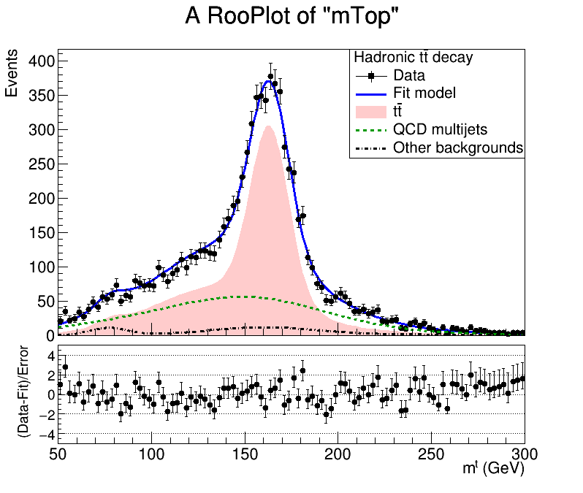
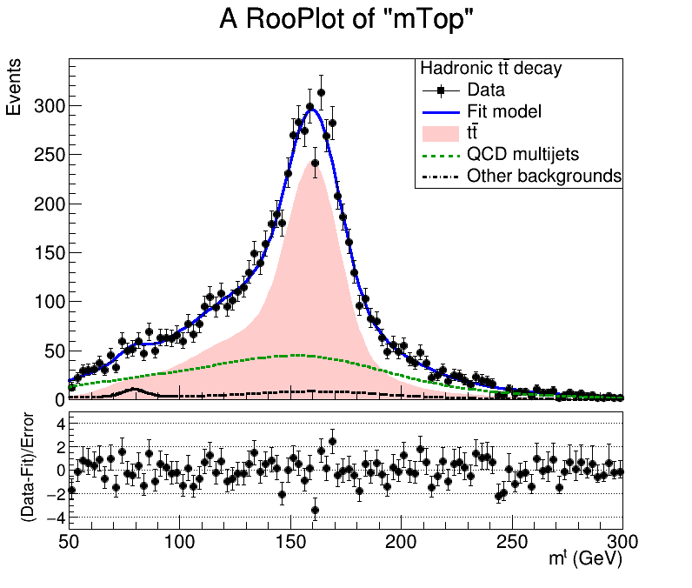
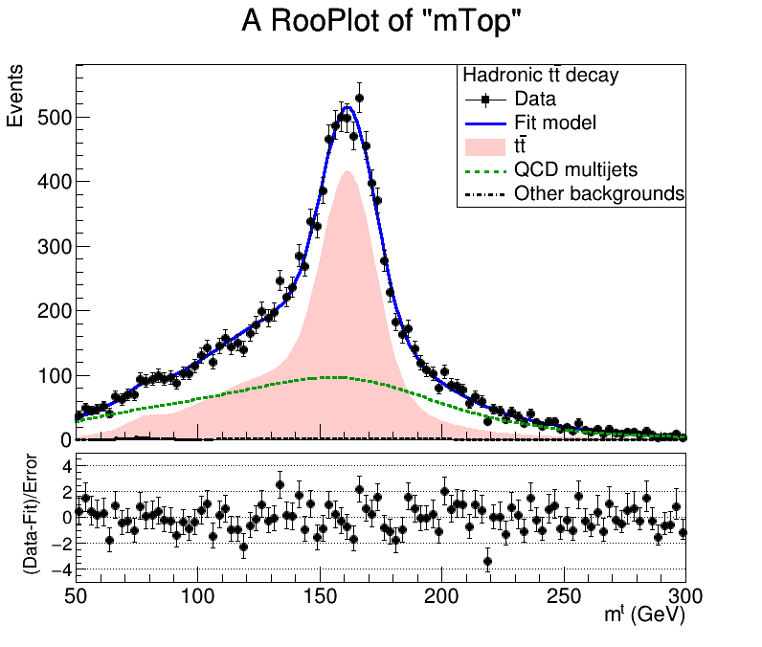
Mass Fit in Signal Region for 2016, 2017, 2018
Signal Region (2btag) (2016)
Signal Region (2btag) (2017)
Signal Region (2btag) (2018)
Signal Strength: r = 0.69 ± 0.026
Signal Strength: r = 0.64 ± 0.024
Signal Strength: r = 0.68 ± 0.02
Result of the fit on data in SR. The red area shows the ttbar contribution, the green line shows the QCD, and the black line shows the subdominant backgrounds

Slide 19
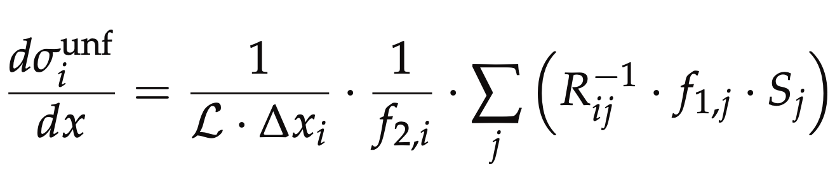
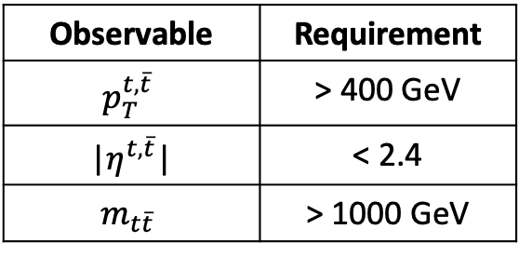
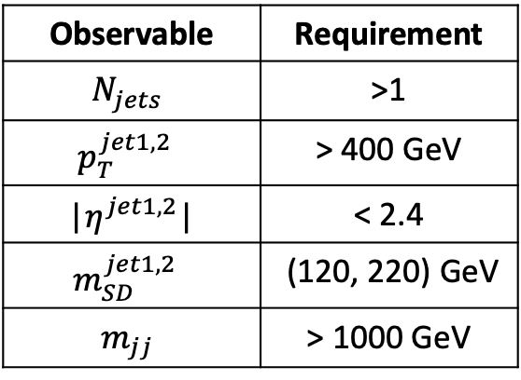
Parton & Particle levels
Particle level Top Candidates
Parton
Observable | Requirement
$$N_{jets}$$ | >1
$$p_{T}^{jet1, 2 }$$ | > 400 GeV
|$η^{jet1, 2}$| | < 2.4
$$m_{SD}^{jet1, 2 }$$ | (120, 220) GeV
$$m_{jj}$$ | > 1000 GeV
Observable | Requirement
$$p_{T}^{t,\overline{t}}$$ | > 400 GeV
|$η^{t,\overline{t}}$| | < 2.4
$$m_{t\overline{t}}$$ | > 1000 GeV
Parton Phase space
Reco/Fiducial Phase space
efficiency of the reco+true selection
reco efficiency of the reco+true selection
migration matrix
Unfolding: simple response matrix inversion w/o regularisation

Slide 20
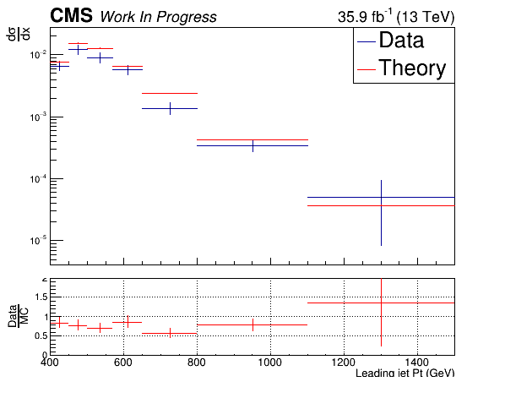
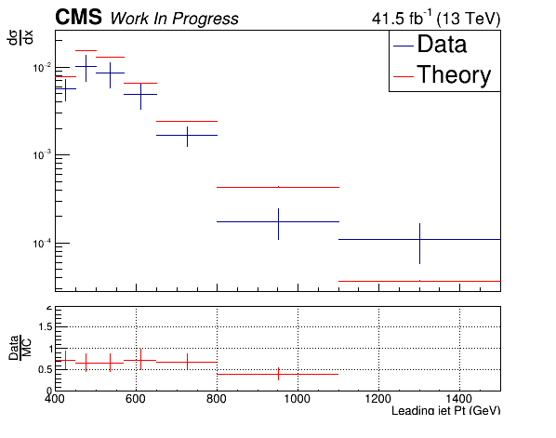
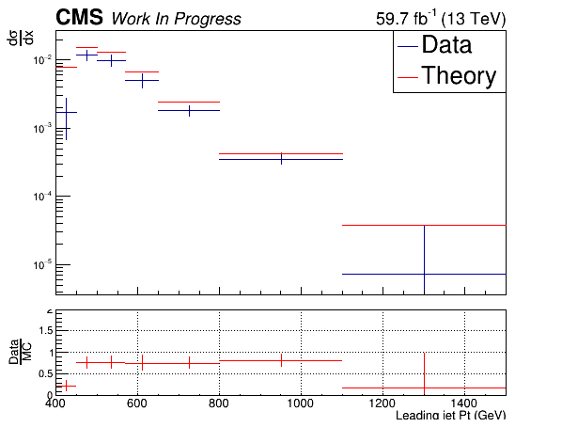
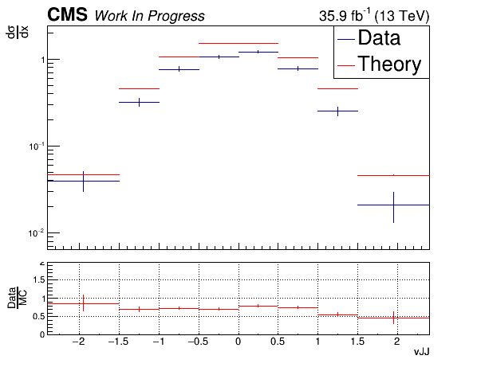
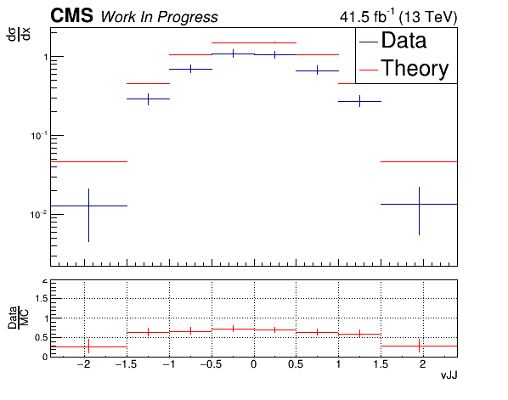
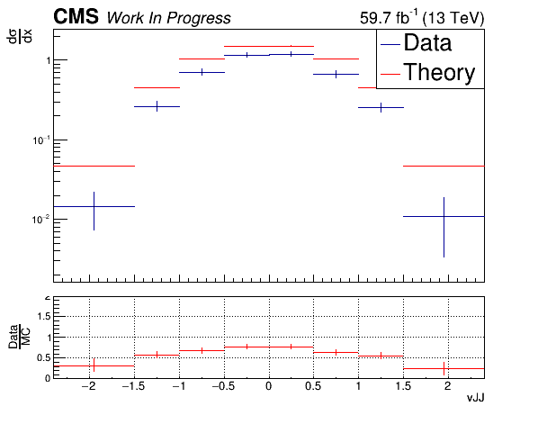
Unfolding - Extrapolation to Parton/Particle Level, Data vs MC
(2016)
(2017)
(2018)

Slide 21
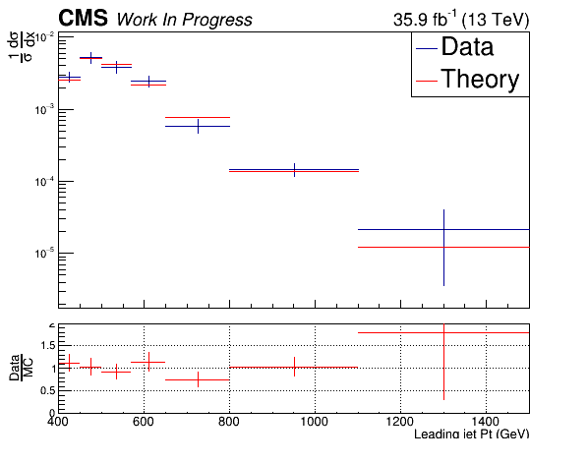
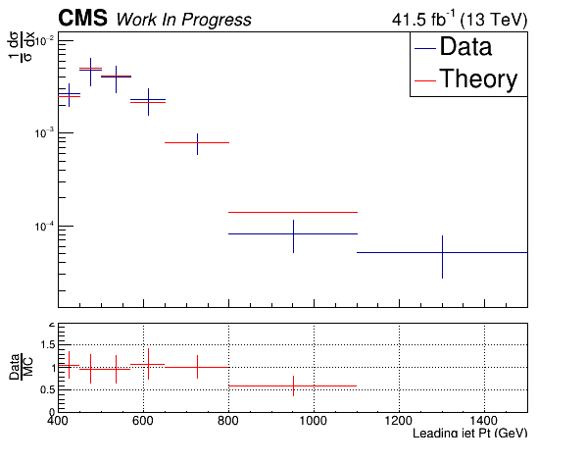
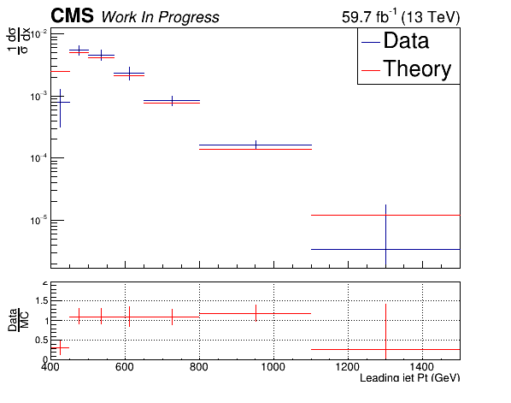
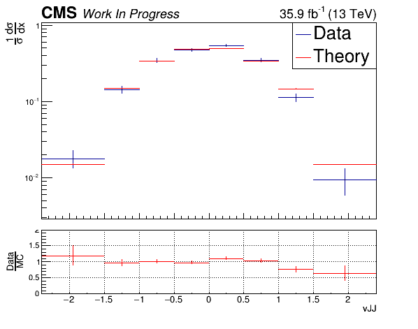
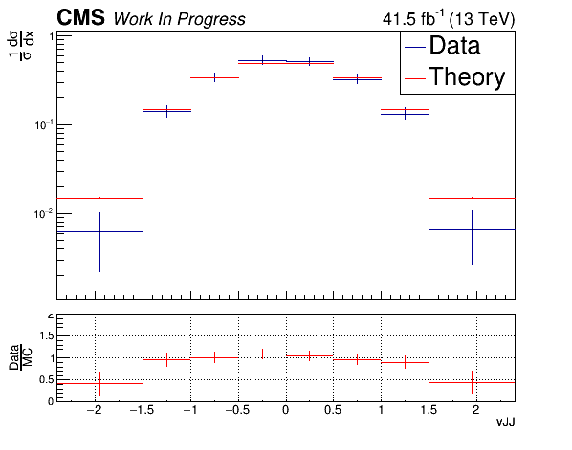
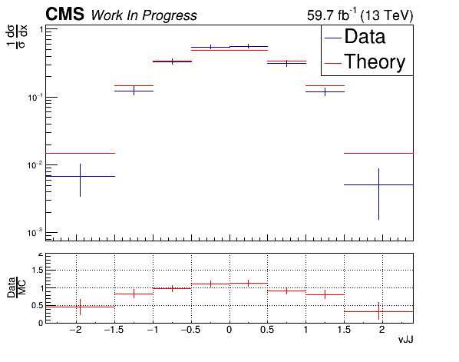
Unfolding - Extrapolation to Parton/Particle Level, Data vs MC (Normalised)
(2016)
(2017)
(2018)

Slide 22
CERN Phase2 upgrade
LHC will upgrade to High Luminosity LHC (HL - LHC) between 2023 and 2025
Higher luminosity
Higher radiation doses than the ones the detectors were designed for
Higher pileup
CMS will replace most of its subdetectors to mitigate with the LHC upgrades
High Granularity CALorimeter (HGCAL) will replace the endcap calorimeters.

Slide 23
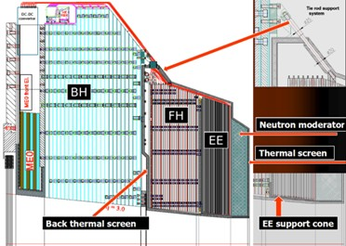
High Granularity Calorimeter (HGCAL)
Phase 2 Upgrade

Slide 24
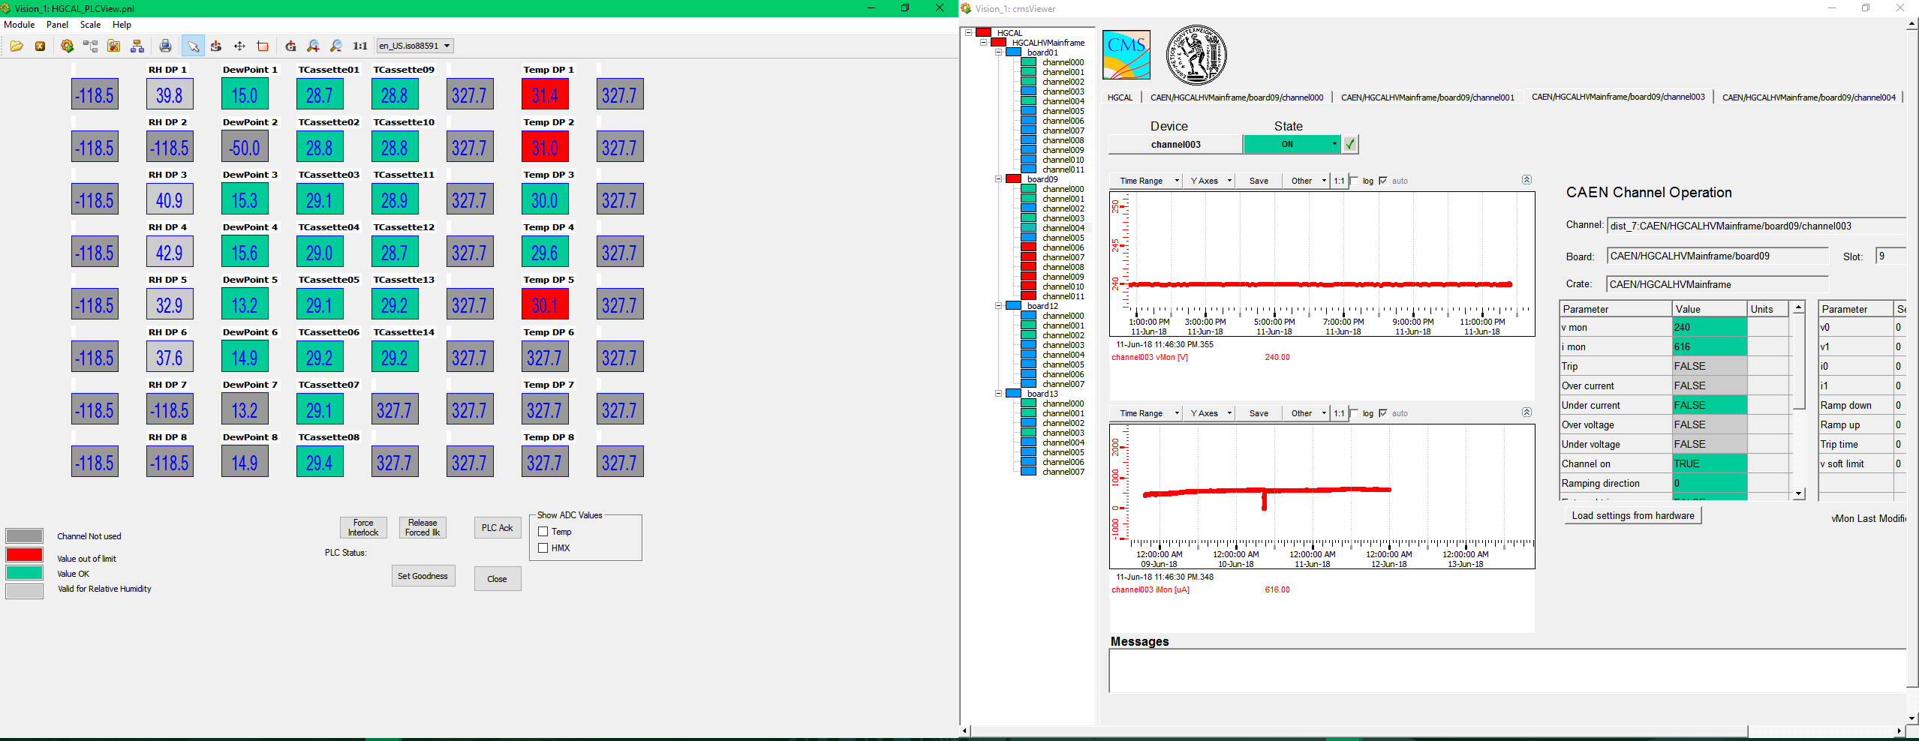
High Granularity Calorimeter (HGCAL)

Slide 25
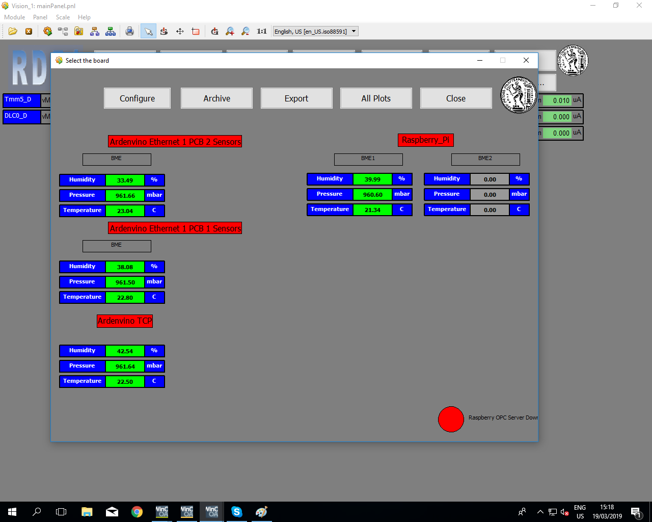
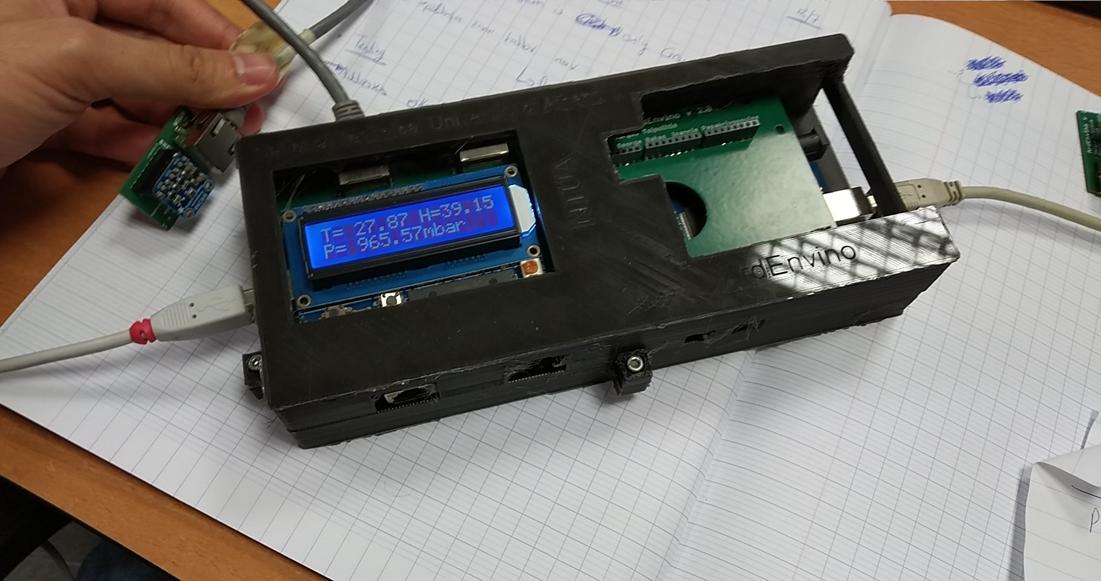
Environmental Monitoring for the RD51 Test Beams
Development of the slow control system
Developed environmental monitoring system
Support during test beams

Slide 26
BACKUP SLIDES

Slide 27
Signal Selection
Control Region Selection
Variables | Selected Cut
pT (both leading jets) | > 400 GeV
Njets | > 1
N leptons | = 0
|eta| (both leading jets) | < 2.4
mJJ | > 1000 GeV
jetMassSoftDrop (only for fit) | (50,300) GeV
Top Tagger | > 0.2, 0, 0.1
B tagging (2 btagged jets) | > Medium WP
Signal Trigger
Variables | Selected Cut
pT (both leading jets) | > 400 GeV
Njets | > 1
N leptons | = 0
|eta| (both leading jets) | < 2.4
mJJ | > 1000 GeV
jetMassSoftDrop (only for fit) | (50,300) GeV
Top Tagger | > 0.2, 0, 0.1
B tagging (0 btagged jets) | < Medium WP
Control Trigger

Slide 28
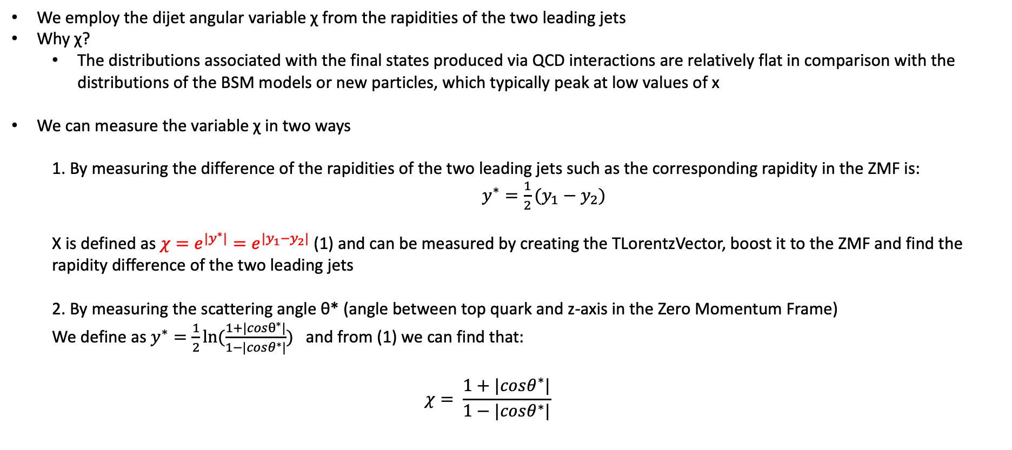
Top Angular Distributions
We employ the dijet angular variable χ from the rapidities of the two leading jets
Why χ?
The distributions associated with the final states produced via QCD interactions are relatively flat in comparison with the distributions of the BSM models or new particles, which typically peak at low values of x
We can measure the variable χ in two ways
1. By measuring the difference of the rapidities of the two leading jets such as the corresponding rapidity in the ZMF is: $y^{∗}=\frac{1}{2}(y_{1}−y_{2})$
Χ is defined as $χ=e^{{|y}^{∗}|}=e^{|y_{1}−y_{2}|}$ (1) and can be measured by creating the TLorentzVector, boost it to the ZMF and find the rapidity difference of the two leading jets
2. By measuring the scattering angle θ* (angle between top quark and z-axis in the Zero Momentum Frame)
We define as $y^{∗}=\frac{1}{2}ln⁡(\frac{1+|cosθ^{∗}|}{1−|cosθ^{∗}|})$ and from (1) we can find that:
$$χ= \frac{1+|cosθ^{∗}|}{1−|cosθ^{∗}|}$$

Slide 29
Overview: Discriminator, Efficiency and Acceptance
2016
The discriminator is a BDT trained individually for 2016, 2017 and 2018
Category training: split the sample in categories based on Pt
Bins:
[400, 600] GeV
[600, 800] GeV
[800, 1200] GeV
[1200, inf) GeV
BDT, used variables:
Leading and Sub-leading subjet mass
N-Subjetiness variables (tau1, tau2, tau3)
fraction of the jetPt over the total pt sum of the event.
Energy correlation functions (ecfB1N2,ecfB1N3, ecfB2N2, ecfB2N3)
BDT Output consistency for the 3 years
Calculation of Efficiency and acceptance for each year
We choose the WP’s for each year so that the leading jet p_{T} efficiency is similar for all years
2017
2018

Slide 30
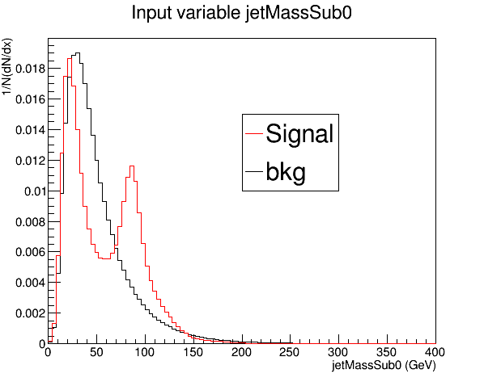
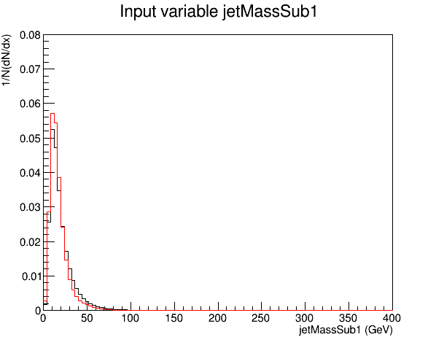
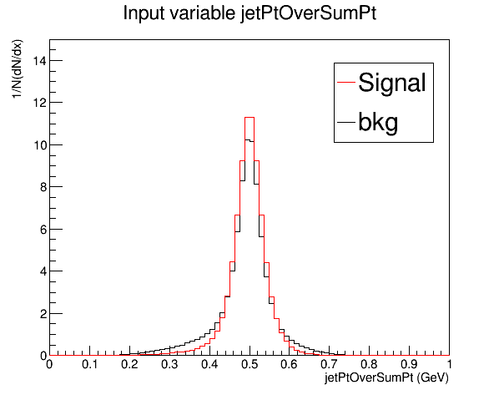
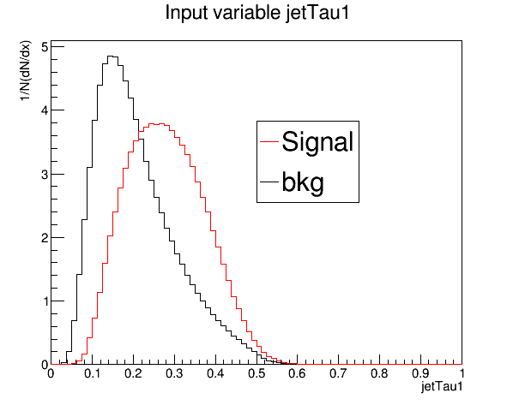


Training variables 2017

Slide 31




Training variables 2017

Slide 32

Signal Extraction
$$S_{1.5TeV}\left(x_{reco}\right)=D_{1.5TeV}\left(x_{reco}\right)−QCD_{1.5TeV}\left(x_{reco}\right)−Sub_{1.5TeV}\left(x_{reco}\right)→$$
Where $QCD_{1.5TeV}\left(x_{reco}\right)=D_{1.5TeV, shape}^{0−btag}\left(x_{reco}\right)xN_{SR(1.5TeV)}{xC}_{closure}^{shape SF}$
and $N_{SR(1.5TeV)}=R_{yield}^{1TeV→1.5TeV}xN_{SR\left(1TeV\right)}^{QCD}=R_{yield}^{1TeV→1.5TeV}xR_{yield}^{SR_{A}→SR} {xN}_{SR_{A}}^{QCD}$
The variable of interest here: x_{reco} → χ
1.5 TeV refers to the mJJ cut
We deploy a fit in the Signal Region (2btag) to extract the $N_{QCD}^{fit}$ in SRA (mJJ > 1TeV)
$$D{\left(m^{t}\right)}^{(i)}=N_{tt}^{(i)}T^{(i)}\left(m^{t},k_{MassScale}, k_{MassResolution}\right)+N_{bkg}^{(i)}B\left(m^{t} \right)\left(1+k_{1}x\right)+N_{sub}^{(i)}O^{(i)}\left(m^{t}\right)$$

